Slide 1

AMACSS Seminar
Term Test 1 Review

Slide 2
Possible topics on the term test
ADT’s
Designing an ADT
Coding an ADT from a docstring
Writing a docstring for an ADT
Containers
Manipulating containers to achieve a certain goal
Linked Lists
Operations on linked lists
Blackbox testing
Testing an ADT without knowing how it’s implemented
Notes:
Using isinstance() to check if something is of a certain type
Classes are created using camelCase

Slide 3
Making a stack out of queues, and vice versa
1 Stack = 2 Queues
How? Well let’s take a look…
Notes:
Using isinstance() to check if something is of a certain type
Classes are created using camelCase

Slide 4
Try to make a Queue out of stacks
Notes:
Using isinstance() to check if something is of a certain type
Classes are created using camelCase

Slide 5
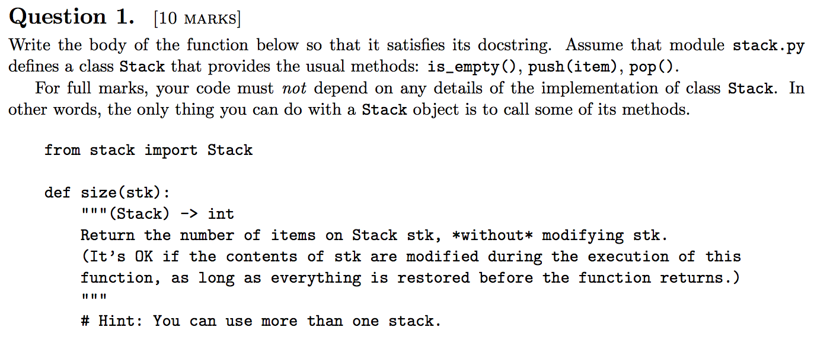
Try the following question
Notes:
Using isinstance() to check if something is of a certain type
Classes are created using camelCase

Slide 6
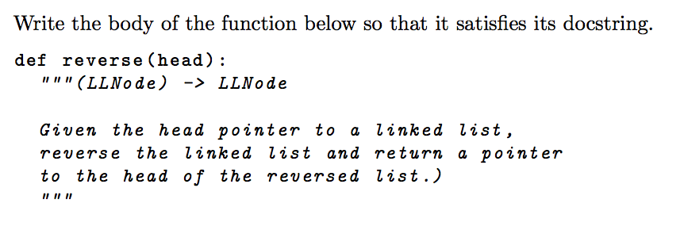
Try the following question
Notes:
Using isinstance() to check if something is of a certain type
Classes are created using camelCase

Slide 7
Write testcases for your banana_verify function from exercise 2. These testcases don’t need to be written in unittest format, but the assertions should be written in proper assertion format. i.e assertEqual, etc.
Your testcases should include examples where:
- To many letters in source or goal
More gets than puts
Too many moves
Too little moves
Notes:
Using isinstance() to check if something is of a certain type
Classes are created using camelCase

